Slide 1




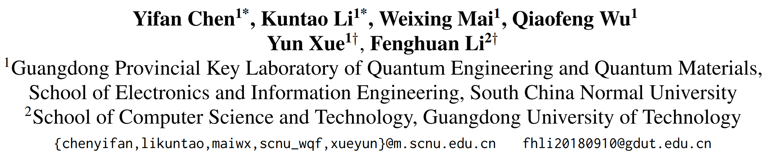





ATAI
Advanced Technique of Artificial Intelligence
ATAI
ChongqingUniversity _{AdvancedTechniqueof}
of Technology Artificial Intelligence
Chongqing University of Technology
Chongqing University ^{ATAI}
_{of Technology} Advanced Techniqueof
Artificial Intelligence
Chongqing University of Technology
Chongqing University of Technology
  D2R:Dual-Branch Dynamic Routing Network for Multimodal Sentiment Detection
Code: NULL
2025.1.2•ChongQing
——EMNLP 2024
Reported by Lele Ren
1

Slide 2

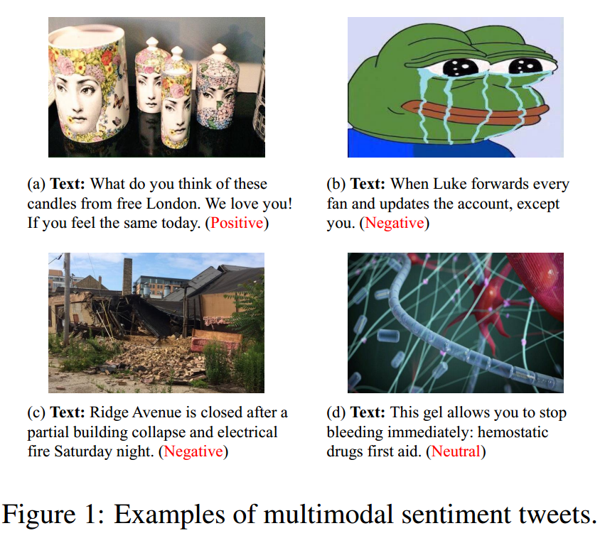
ATAI
AdvancedTechniqueof
Artificial Intelligence
ATAI
ChongqingUniversity _{AdvancedTechniqueof}
of Technology Artificial Intelligence
ChongqingUniversity of Technology
Motivation
Existing multimodal sentiment analysis methods tend to be overly homogeneous in their interaction patterns, which may introduce unnecessary noise when handling simple samples, while failing to capture sufficient emotional information when dealing with complex samples.

Slide 3

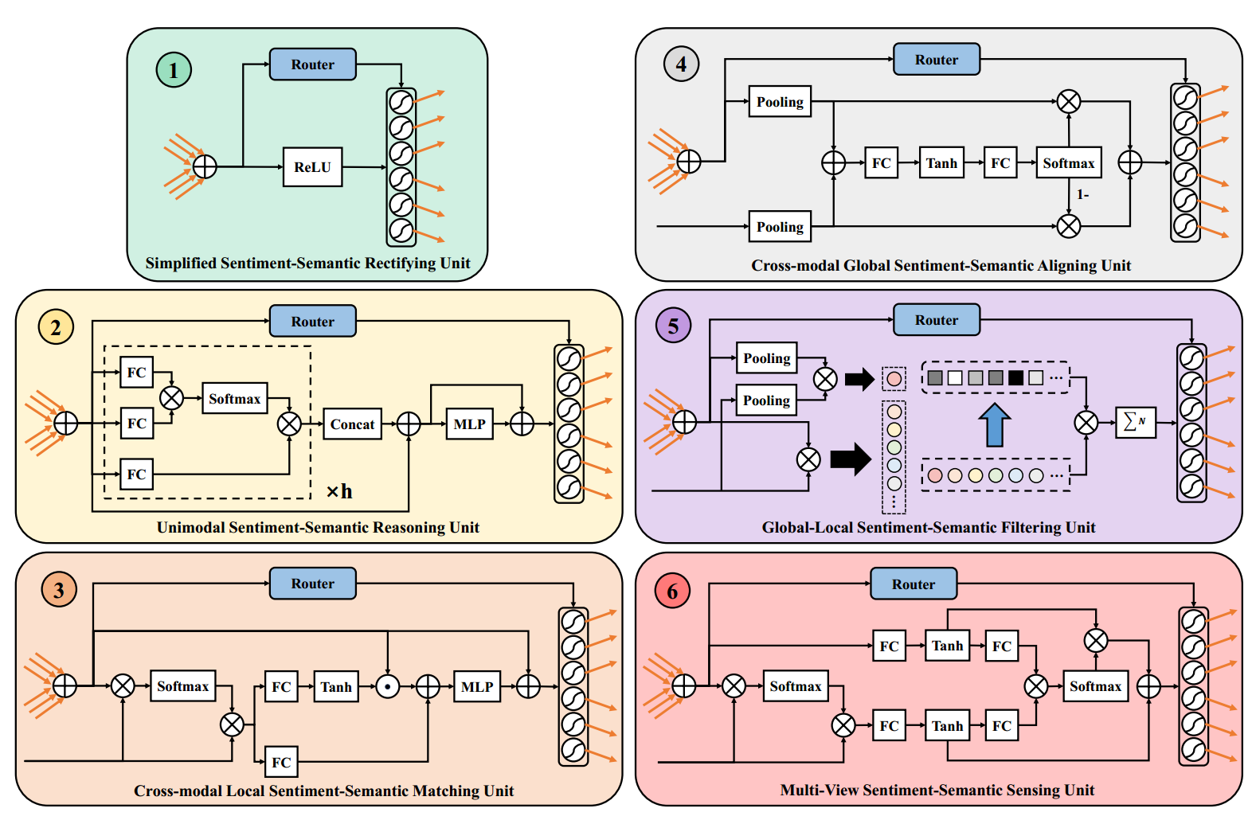
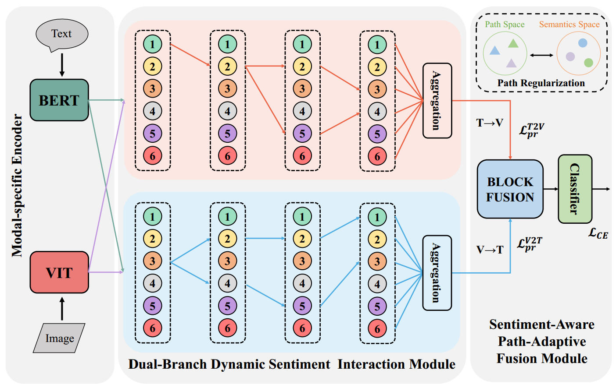
ChongqingUniversity of Technology
ATAI
AdvancedTechniqueof
Artificial Intelligence
ATAI
ChongqingUniversity _{AdvancedTechniqueof}
of Technology Artificial Intelligence
Overview

Slide 4

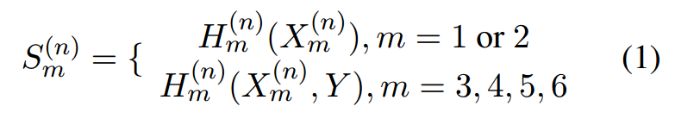
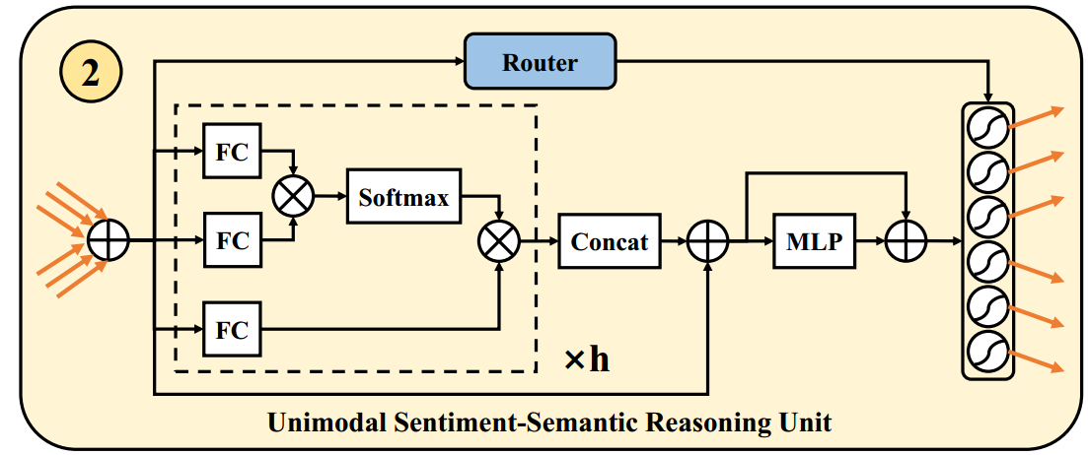
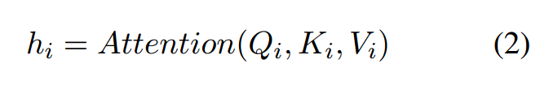
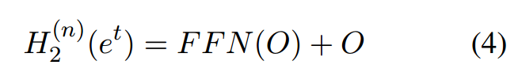
ChongqingUniversity of Technology
ATAI
AdvancedTechniqueof
Artificial Intelligence
ATAI
ChongqingUniversity _{AdvancedTechniqueof}
of Technology Artificial Intelligence
Method

Slide 5
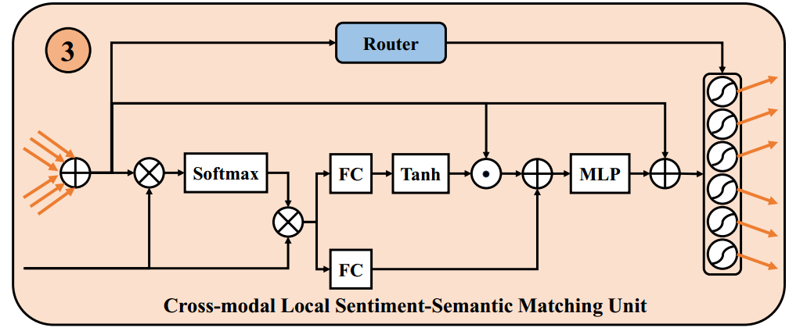
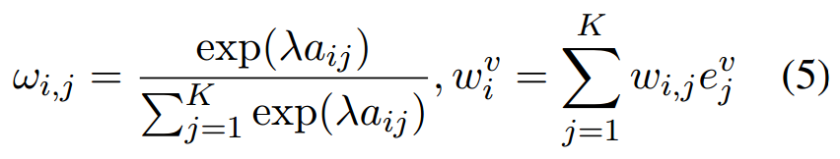
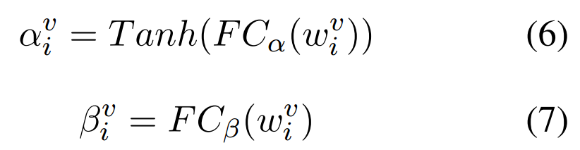

ChongqingUniversity of Technology
ATAI
AdvancedTechniqueof
Artificial Intelligence
ATAI
ChongqingUniversity _{AdvancedTechniqueof}
of Technology Artificial Intelligence
Method

Slide 6
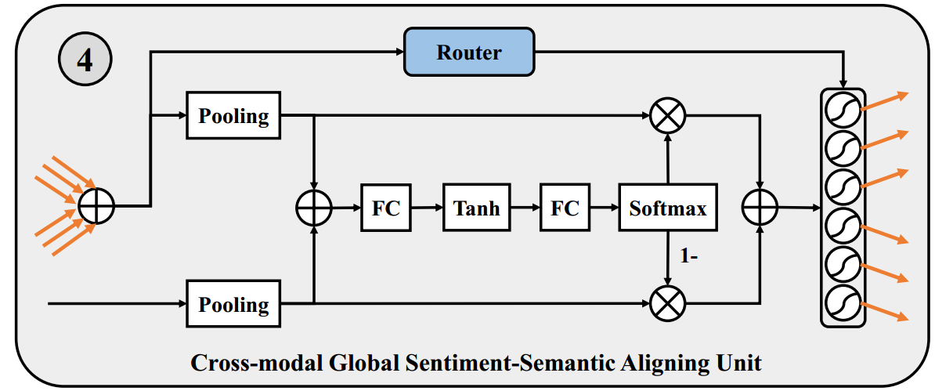
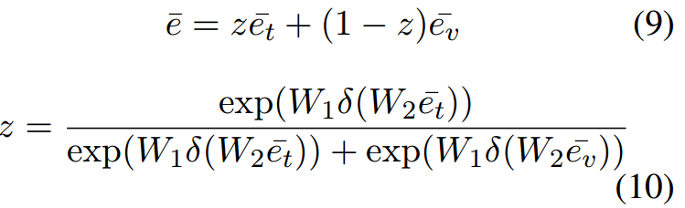

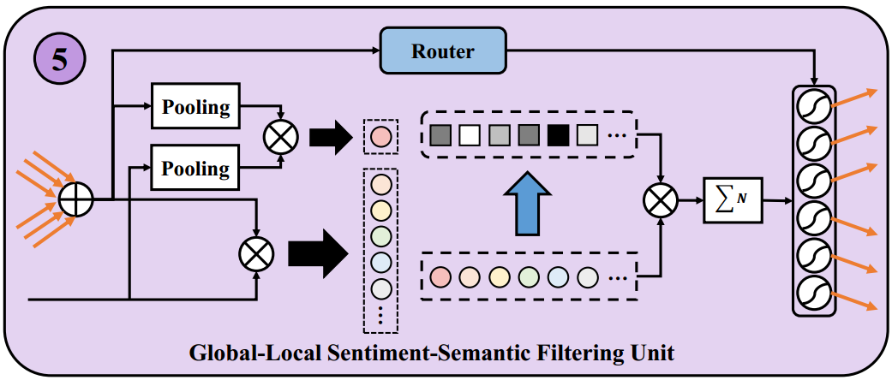
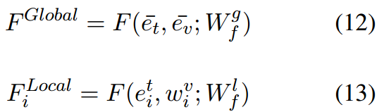
ChongqingUniversity of Technology
ATAI
AdvancedTechniqueof
Artificial Intelligence
ATAI
ChongqingUniversity _{AdvancedTechniqueof}
of Technology Artificial Intelligence
Method

Slide 7
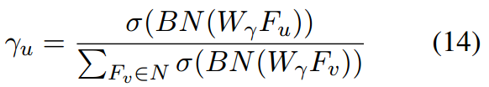


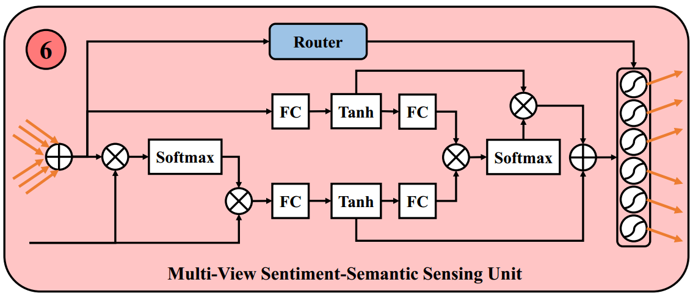
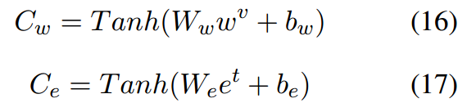

ATAI
AdvancedTechniqueof
Artificial Intelligence
ATAI
ChongqingUniversity _{AdvancedTechniqueof}
of Technology Artificial Intelligence
ChongqingUniversity of Technology
Method

Slide 8
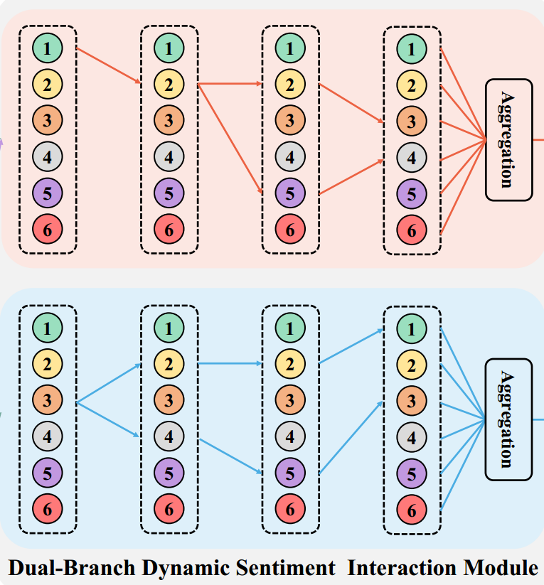
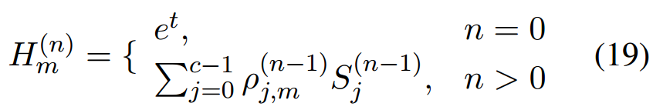
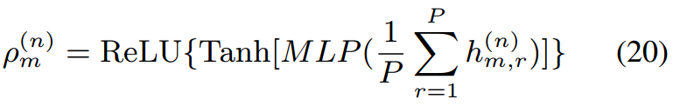
ATAI
AdvancedTechniqueof
Artificial Intelligence
ATAI
ChongqingUniversity _{AdvancedTechniqueof}
of Technology Artificial Intelligence
ChongqingUniversity of Technology
Method

Slide 9
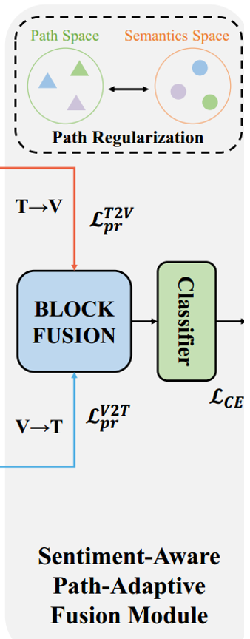




ATAI
AdvancedTechniqueof
Artificial Intelligence
ATAI
ChongqingUniversity _{AdvancedTechniqueof}
of Technology Artificial Intelligence
ChongqingUniversity of Technology
Method

Slide 10

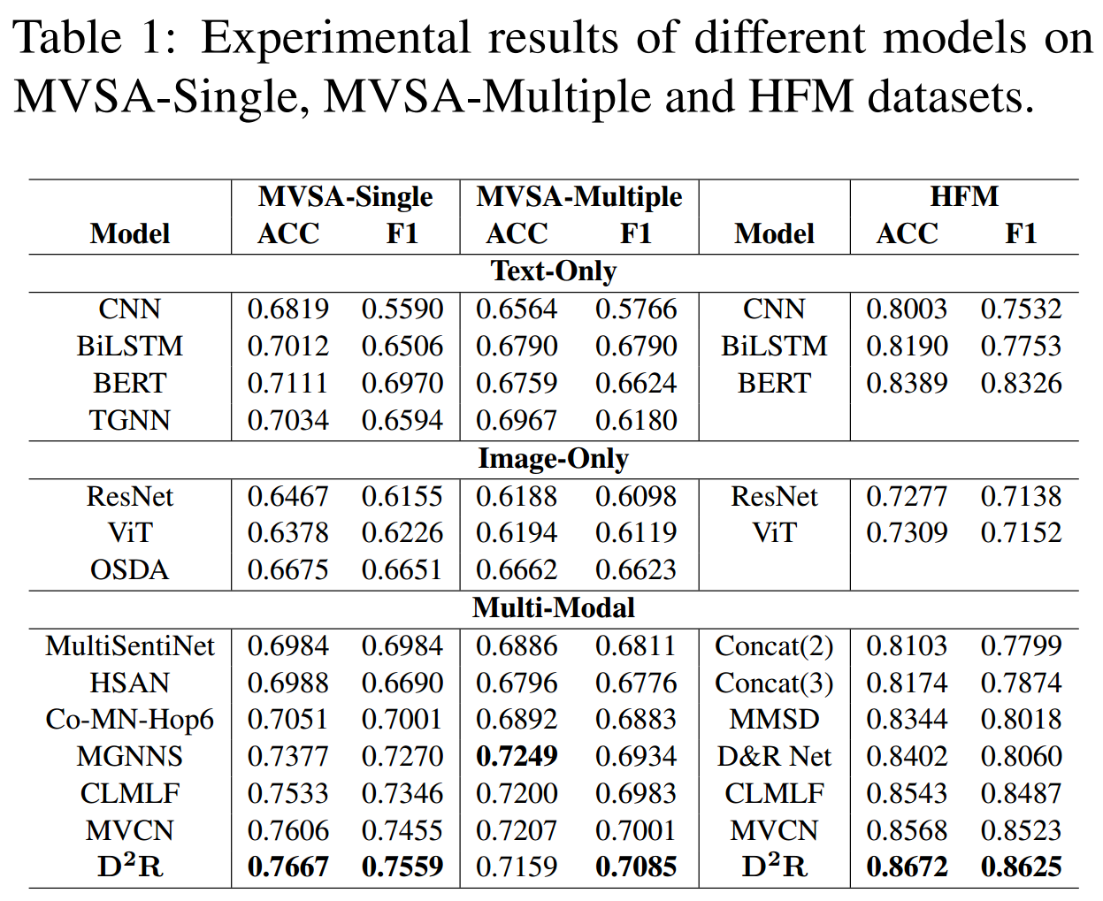
ATAI
AdvancedTechniqueof
Artificial Intelligence
ATAI
ChongqingUniversity _{AdvancedTechniqueof}
of Technology Artificial Intelligence
ChongqingUniversity of Technology
Experiments

Slide 11
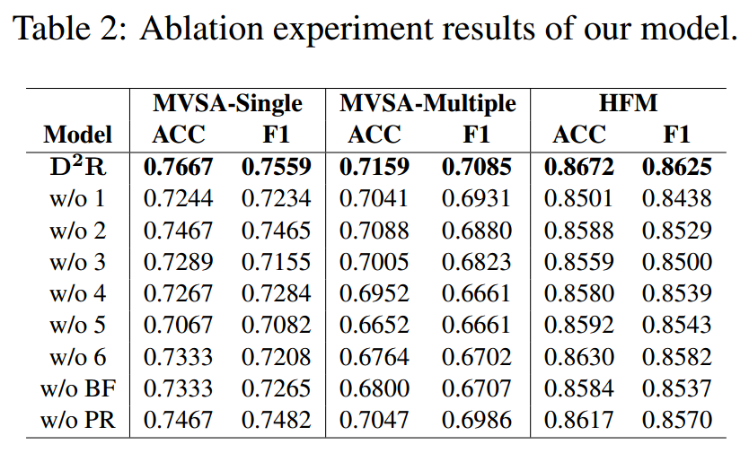
ATAI
AdvancedTechniqueof
Artificial Intelligence
ATAI
ChongqingUniversity _{AdvancedTechniqueof}
of Technology Artificial Intelligence
ChongqingUniversity of Technology
Experiments

Slide 12
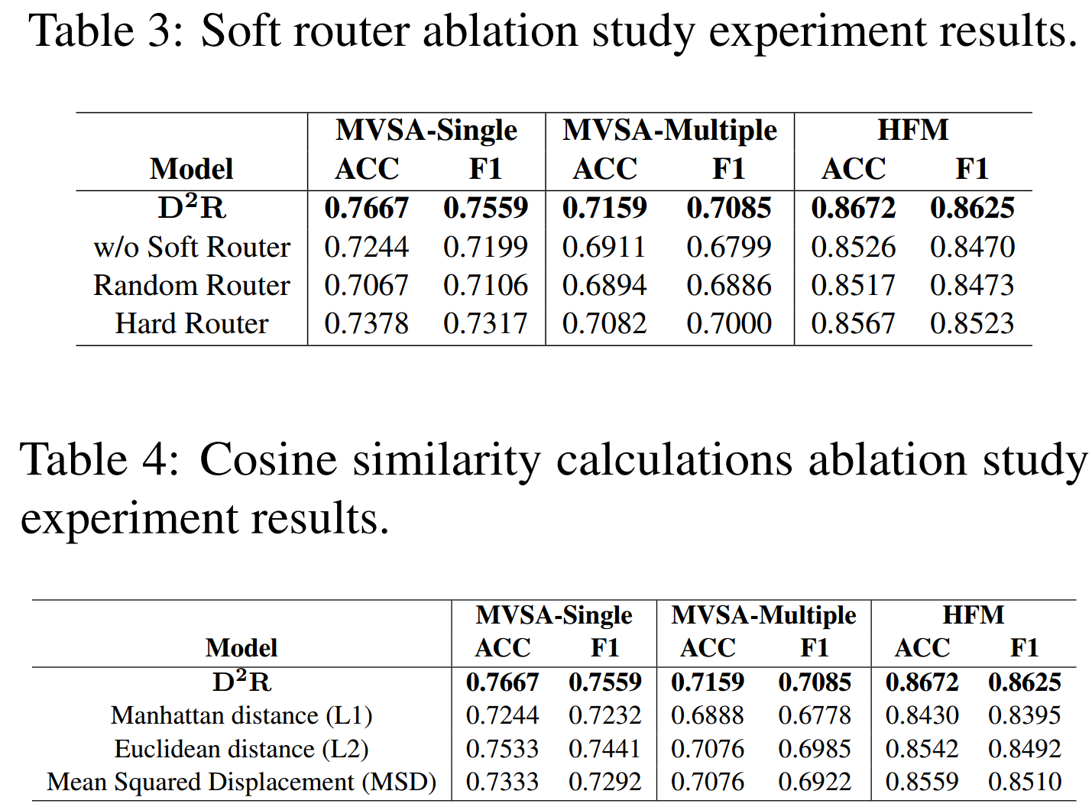
ATAI
AdvancedTechniqueof
Artificial Intelligence
ATAI
ChongqingUniversity _{AdvancedTechniqueof}
of Technology Artificial Intelligence
ChongqingUniversity of Technology
Experiments

Slide 13
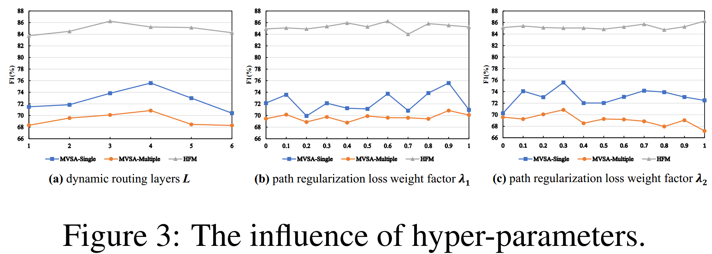
ATAI
AdvancedTechniqueof
Artificial Intelligence
ATAI
ChongqingUniversity _{AdvancedTechniqueof}
of Technology Artificial Intelligence
ChongqingUniversity of Technology
Experiments

Slide 14
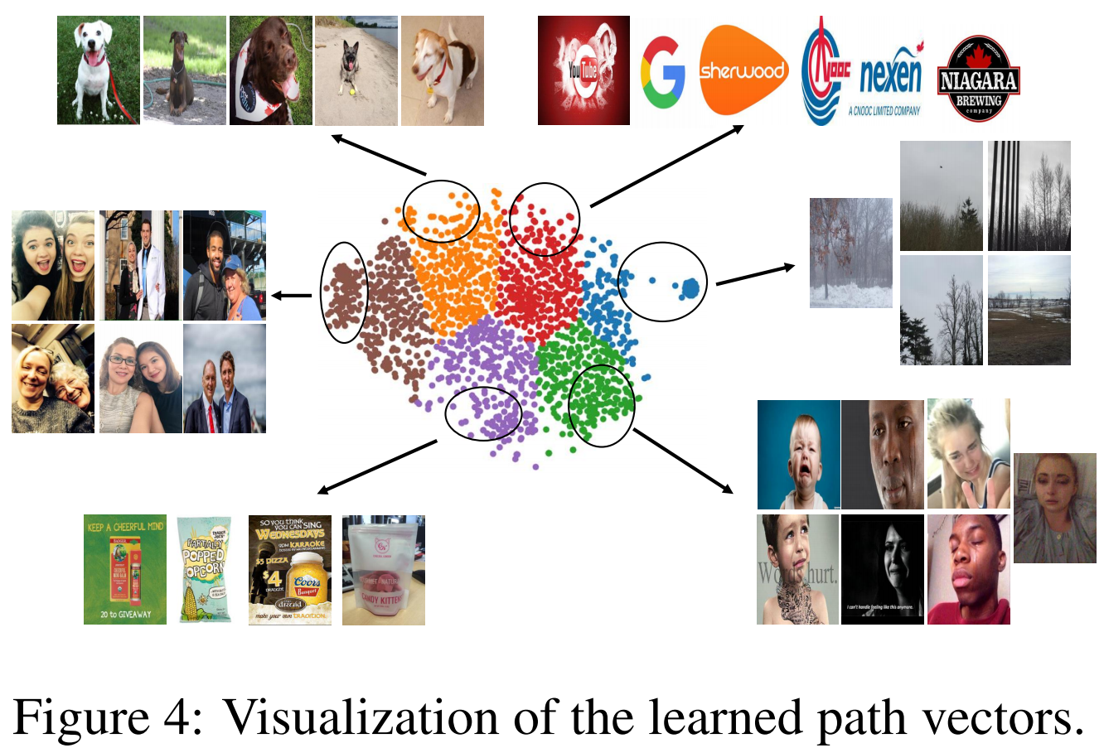
ATAI
AdvancedTechniqueof
Artificial Intelligence
ATAI
ChongqingUniversity _{AdvancedTechniqueof}
of Technology Artificial Intelligence
ChongqingUniversity of Technology
Experiments

Slide 15


ChongqingUniversity of Technology
ATAI
AdvancedTechniqueof
Artificial Intelligence
ATAI
ChongqingUniversity _{AdvancedTechniqueof}
of Technology Artificial Intelligence
Thanks!

